Slide 1
NoSQL

Slide 2
What is NoSQL?
A No SQL database provides a mechanism for storage and retrieval of data that employs less constrained consistency models than traditional relational database
No SQL systems are also referred to as "NotonlySQL“ to emphasize that they do in fact allow SQL-like query languages to be used

Slide 3
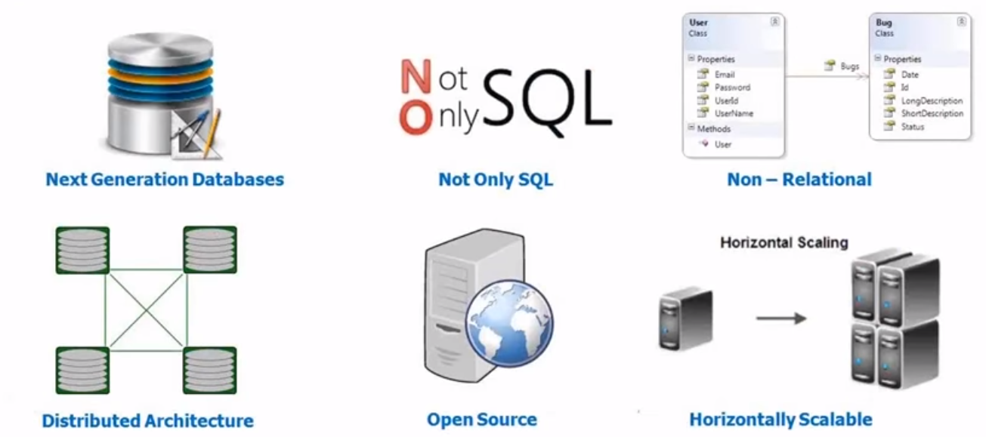
What is NoSQL?

Slide 4
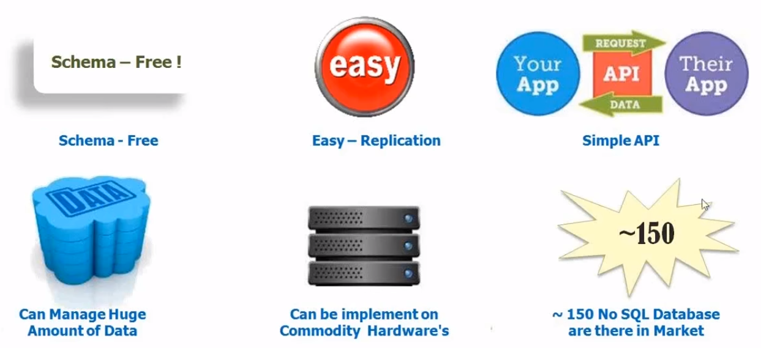
What is NoSQL?

Slide 5
Characteristics of NoSQL databases
NoSQL avoids:
Overhead of ACID transactions
Complexity of SQL query
Burden of up-front schema design
DBA presence
Transactions (It should be handled at application layer)
Provides:
Easy and frequent changes to DB
Fast development
Large data volumes(eg.Google)

Slide 6
Why NoSQL
In today’s time data is becoming easier to access and capture through third parties such as Facebook, Google+ and others
Personal user information, social graphs, geo location data, user-generated content and machine logging data are just a few examples where the data has been increasing exponentially
To avail the above service properly, it is required to process huge amount of data
Which SQL databases were never designed
The evolution of NoSql databases is to handle these huge data properly

Slide 7
Types of Data
Data can be broadly classified into four types:
Structured Data:
Have a predefined model, which organizes data into a form that is relatively easy to store, process, retrieve and manage
E.g., relational data
Unstructured Data:
Opposite of structured data
E.g., Flat binary files containing text, video or audio
Note: data is not completely devoid of a structure (e.g., an audio file may still have an encoding structure and some metadata associated with it)

Slide 8
Types of Data
Data can be broadly classified into four types:
Dynamic Data:
Data that changes relatively frequently
E.g., office documents and transactional entries in a financial database
Static Data:
Opposite of dynamic data
E.g., Medical imaging data from MRI or CT scans

Slide 9
Why Classifying Data?
Segmenting data into one of the following 4 quadrants can help in designing and developing a pertaining storage solution
Relational databases are usually used for structured data
File systems or NoSQL databases can be used for (static), unstructured data (more on these later)
Dynamic
Static
Media Production, eCAD, mCAD, Office Docs
Media Archive, Broadcast, Medical Imaging
Unstructured
Transaction Systems, ERP, CRM
BI, Data Warehousing
Structured

Slide 10
Scaling Traditional Databases
Traditional RDBMSs can be either scaled:
Vertically (or Up)
Can be achieved by hardware upgrades (e.g., faster CPU, more memory, or larger disk)
Limited by the amount of CPU, RAM and disk that can be configured on a single machine
Horizontally (or Out)
Can be achieved by adding more machines
Requires database sharding and probably replication
Limited by the Read-to-Write ratio and communication overhead

Slide 11
Why Sharding Data?
Data is typically sharded (or striped) to allow for concurrent/parallel accesses
Input data: A large file
Machine 1
Machine 2
Machine 3
Chunk1 of input data
Chunk3 of input data
Chunk5 of input data
Chunk2 of input data
Chunk4 of input data
Chunk5 of input data
E.g., Chunks 1, 3 and 5 can be accessed in parallel

Slide 12
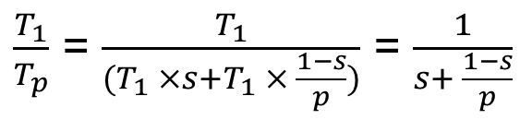
Amdahl’s Law
How much faster will a parallel program run?
Suppose that the sequential execution of a program takes T₁ time units and the parallel execution on p processors/machines takes T_{p} time units
Suppose that out of the entire execution of the program, s fraction of it is not parallelizable while 1-s fraction is parallelizable
Then the speedup (Amdahl’s formula):

Slide 13
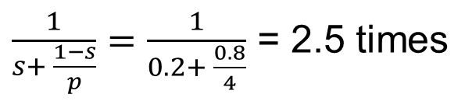
Amdahl’s Law: An Example
Suppose that:
80% of your program can be parallelized
4 machines are used to run your parallel version of the program
The speedup you can get according to Amdahl’s law is:
Although you use 4 processors you cannot get a speedup more than 2.5 times!

Slide 14
Real Vs. Actual Cases
Amdahl’s argument is too simplified
In reality, communication overhead and potential workload imbalance exist upon running parallel programs
Serial
20
80
Serial
20
80
Parallel
20
20
Parallel
20
20
Process 1
Process 1
Process 2
Process 2
Cannot be parallelized
Process 3
Process 3
Cannot be parallelized
Can be parallelized
Process 4
Can be parallelized
Process 4
Communication overhead
Load Unbalance
1. Parallel Speed-up: An Ideal Case
2. Parallel Speed-up: An Actual Case

Slide 15
Some Guidelines
Here are some guidelines to effectively benefit from parallelization:
Maximize the fraction of your program that can be parallelized
Balance the workload of parallel processes
Minimize the time spent for communication

Slide 16
Why Replicating Data?
Replicating data across servers helps in:
Avoiding performance bottlenecks
Avoiding single point of failures
And, hence, enhancing scalability and availability

Slide 17

Why Replicating Data?
Replicating data across servers helps in:
Avoiding performance bottlenecks
Avoiding single point of failures
And, hence, enhancing scalability and availability
Main Server
Replicated Servers

Slide 18
Types of NoSQL Databases
Here is a limited taxonomy of NoSQL databases:
NoSQL Databases
Document Stores
Graph Databases
Key-Value Stores
Columnar Databases

Slide 19
Document Stores
Documents are stored in some standard format or encoding (e.g., XML, JSON, PDF or Office Documents)
These are typically referred to as Binary Large Objects (BLOBs)
Documents can be indexed
This allows document stores to outperform traditional file systems
E.g., MongoDB and CouchDB (both can be queried using MapReduce)

Slide 20
Types of NoSQL Databases
Here is a limited taxonomy of NoSQL databases:
NoSQL Databases
Document Stores
Graph Databases
Key-Value Stores
Columnar Databases

Slide 21
Graph Databases
Data are represented as vertices and edges
Graph databases are powerful for graph-like queries (e.g., find the shortest path between two elements)
E.g., Neo4j and VertexDB
Id:100
Label: knows
Since: 2001/10/03
Id: 2
Name: Bob
Age: 22
Id:101
Label: knows
Since: 2001/10/03
Id: 1
Name: Alice
Age: 18
Id:105
Label: is_member
Since: 2011/02/14
Id:104
Label: Members
Id:103
Label: Members
Id: 3
Name: Chess
Type: Group
Id:102
Label: is_member
Since: 2005/07/01

Slide 22
Types of NoSQL Databases
Here is a limited taxonomy of NoSQL databases:
NoSQL Databases
Document Stores
Graph Databases
Key-Value Stores
Columnar Databases

Slide 23
Key-Value Stores
Key-value databases and document databases are quite similar.
Key-value databases are the simplest of the NoSQL databases:
The basic data structure is a dictionary or map.
You can store a value, such as an integer, string, a JSON structure, or an array, along with a key used to reference that value.
For example, a simple key-value database might have a value such as "Douglas Adams". This value is then assigned an ID, such as cust1237

Slide 24
Key-Value Stores
Keys are mapped to (possibly) more complex value (e.g., lists)
Keys can be stored in a hash table and can be distributed easily
Such stores typically support regular CRUD (create, read, update, and delete) operations
That is, no joins and aggregate functions
E.g., Amazon DynamoDB and Apache Cassandra

Slide 25
Types of NoSQL Databases
Here is a limited taxonomy of NoSQL databases:
NoSQL Databases
Document Stores
Graph Databases
Key-Value Stores
Columnar Databases

Slide 26
Columnar Databases
Columnar databases are a hybrid of RDBMSs and Key-Value stores
Values are stored in groups of zero or more columns, but in Column-Order (as opposed to Row-Order)
Values are queried by matching keys
E.g., HBase and Vertica
Record 1
Column A
Column A = Group A
Alice
3
25
Bob
Alice
Bob
Carol
Alice
Bob
Carol
4
19
Carol
0
3
4
0
25
3
25
4
19
45
19
45
0
45
Column Family {B, C}
Row-Order
Columnar (or Column-Order)
Columnar with Locality Groups

